Slide 1
Warming effects on soil microbial abundance and activity is context-dependent on soil, ecosystem, and warming conditions: A meta-analysis

Slide 2
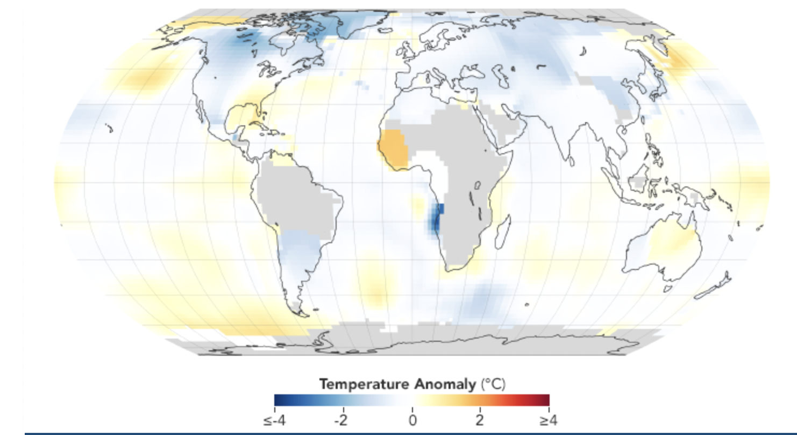
Global Warming
The average global temperature on Earth has increased by a little more than 1° Celsius (2° Fahrenheit) since 1880.
Prediction:
It will rise by 1.5ºC to 2ºC by the end of 21st century
Consequences:
altered the structure and functions of terrestrial ecosystem.
drive disbalance to ecosystem carbon budgeting

Slide 3
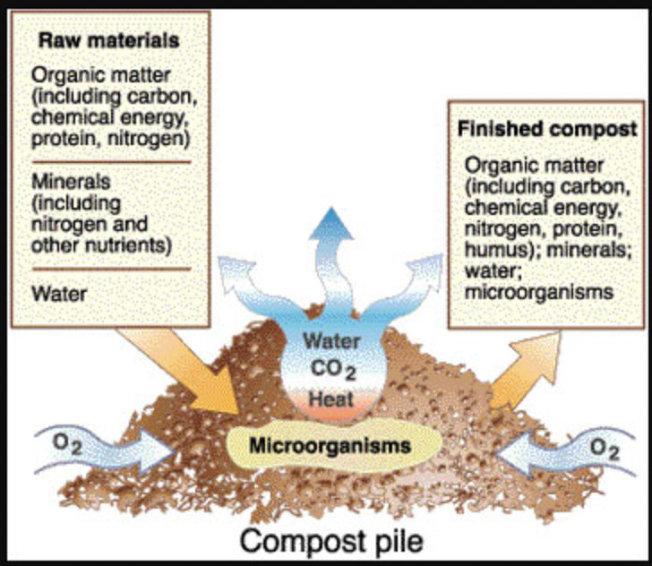
Impact on soil microbes
The soil micro-organisms play a crucial role in determining the terrestrial carbon cycle and climate change feedback, by carrying out SOM decomposition and nutrients cycling
Warming accelerates microbial decomposition, catalysis and degradation of soil enzymes, thus more C released to the atmosphere.
Owing difference in physiology and ecological adaptation, bacteria and fungi respond differently to increased temperature

Slide 4
Microbial response to warming
Not consistent - usually depends on degree and duration of warming, climatic variables and soil characteristics
Zhang et al. (2005) reported total microbial biomass and fungal biomass decreased with the increased soil temperature, however, the total bacterial biomass was not significantly affected.
In contrast, Sheik et al. (2011) found higher total microbial biomass in heated plots than in control plots.
De Angelis et al. (2015) found a 5-degree increase in soil temperature marginally reduced fungal biomass in temperate forest soil whereas Clemmensen et al. (2013) showed that higher soil temperature in boreal forest stimulates the fungal biomass and activity

Slide 5
Purpose
Due to conflicting trend of warming effects on soil microbes from previous studies, we lack proper understanding of how various environmental, climatic and agricultural management factors determine the warming effects on soil micro-organisms.
We sought to explain how soil microbial community composition and activity shifts with elevated soil temperature and what factors influence the warming response to soil microbes using the meta-analytic approach
We compiled the data (mean and standard deviation) from 62 previously published warming experiments and interpreted the effect size associated with each response variable using a mixed-effect model in metaphor package in R to conclude our findings

Slide 6
Methods
Literature Search
Sources:
Web of Science
Google scholar
TTU library database
Keywords:
Experimental warming, elevated temperature, global warming, soil microbial diversity, soil microbial abundance, soil microorganisms, soil bacteria, soil fungi, soil respiration, heterotrophic respiration, soil microbial activity, extracellular enzyme activity etc.

Slide 7
Paper selection criteria
studies had reported control data (mean, sample size, and standard deviation (SD) or standard error (SE) alongside treatment data;
warming experiment lasted for at least one growing season unless it was a lab experiment;
clearly stated warming procedures (e.g., warming technique, the magnitude of warming, and warming duration;
climatic conditions, vegetation, land use, soil physicochemical characteristics were similar between control and treatment plots (in case of laboratory experiments, control and treatment samples incubated at the same temperature);
studies that included interacting factors other than temperature had to be designed with a separate subplot for temperature treatment.
we also excluded warming studies that were conducted in the forest ecosystem.

Slide 8
Data extraction
Total papers shortlisted : 62
Variables of interest:
Microbial biomass carbon (MBC)
Total microbial biomass
Fungal biomass
Bacterial biomass
Total soil respiration
Microbial respiration
Extracellular soil enzyme activity (β-1,4 glucosidase (BG), α-1,4 glucosidase (AG), β-D Cellobiohydrolase (CBH), β-1,4 xylosidase (BX), β-1,4-N acetyl glucosaminidase (NAG), leucine aminopeptidase (LAP), Phosphatase (P), Phenol Oxidase (PHO), and Peroxidase (PEO)

Slide 9
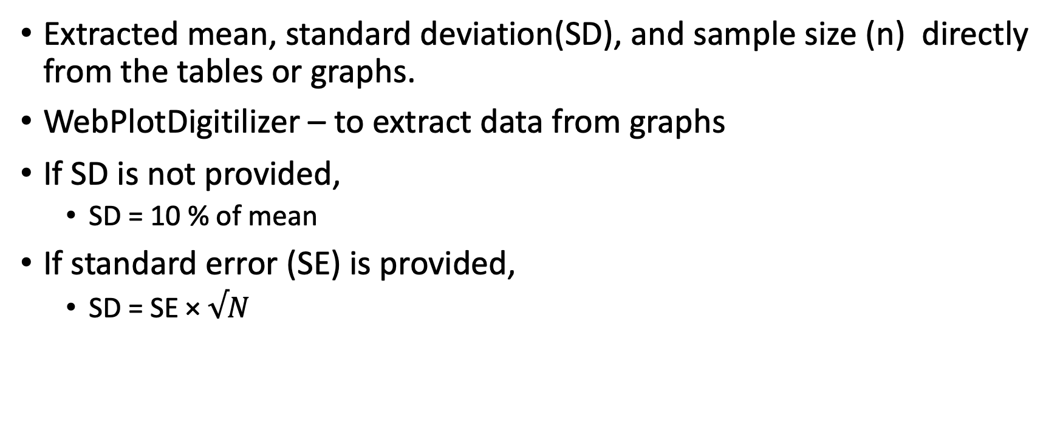
Data extraction
Extracted mean, standard deviation(SD), and sample size (n) directly from the tables or graphs.
WebPlotDigitilizer – to extract data from graphs
If SD is not provided,
SD = 10 % of mean
If standard error (SE) is provided,
SD = SE × $√N$

Slide 10
Data extraction
Other information recorded:
GPS coordinates of study site
Mean annual temperature (MAT) and Mean annual precipitation (MAP)
Ecosystem type
Soil pH
Warming magnitude, method, and duration
Plant type
Irrigation and fertilization status
If MAP, MAT or pH was not given in the paper – obtained those information from global climate and weather database using GPS coordinates
Final dataset: 1622 observations collected from 62 warming studies

Slide 11
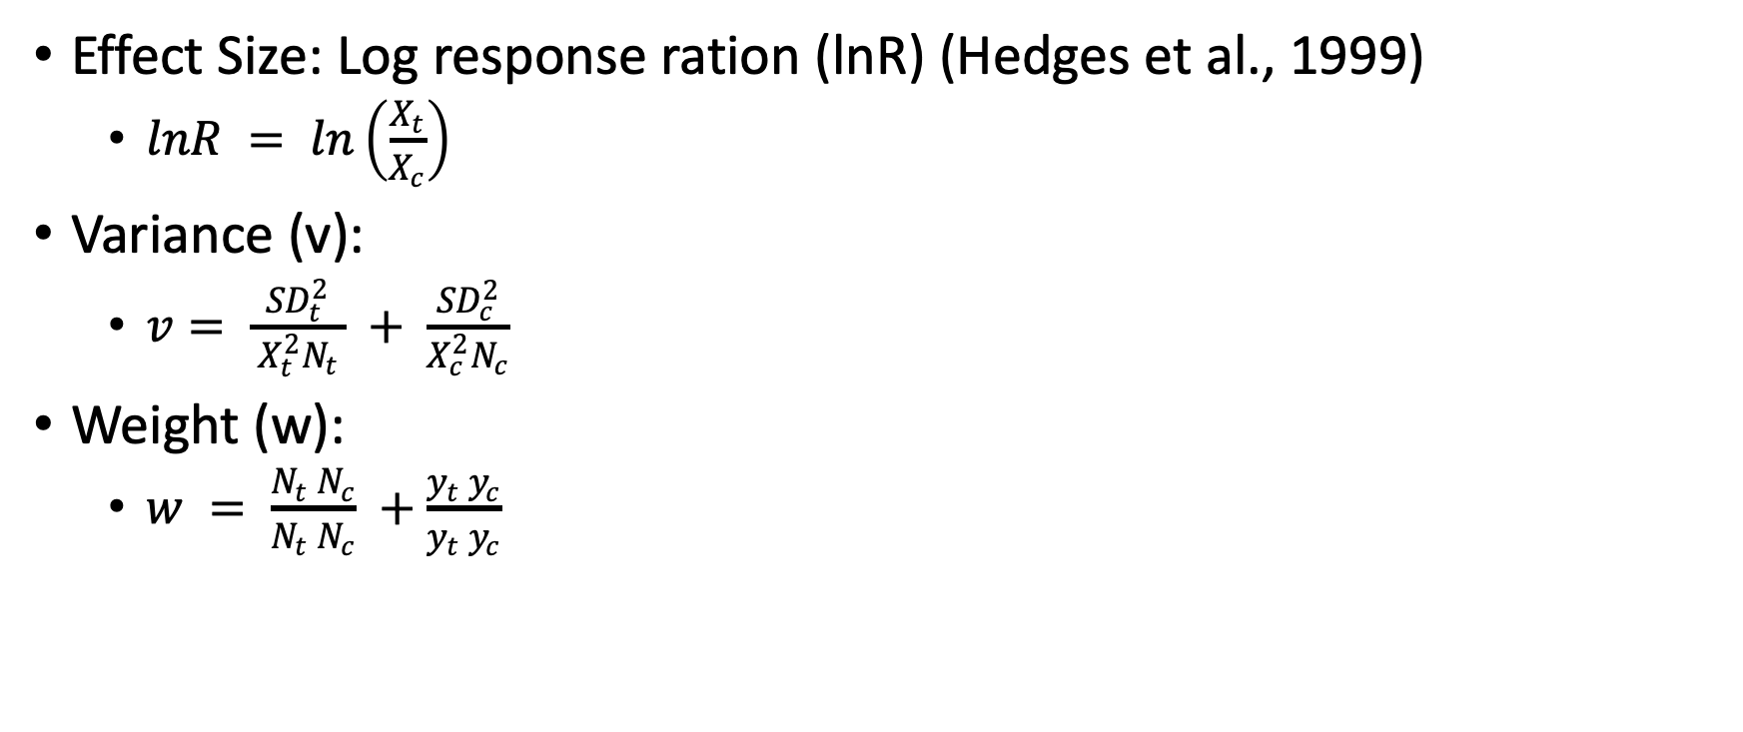
Data preparation and analysis
Effect Size: Log response ration (lnR) (Hedges et al., 1999)
$lnR = ln\left(\frac{X_{t}}{X_{c}}\right)$
Variance (v):
$v= \frac{{SD}_{t}^{2}}{ X_{t}^{2}N_{t }} + \frac{{SD}_{c}^{2}}{X_{c}^{2}N_{c}}$
Weight (w):
$w = \frac{N_{t} N_{c}}{N_{t} N_{c}} +\frac{y_{t} y_{c}}{y_{t} y_{c}}$

Slide 12
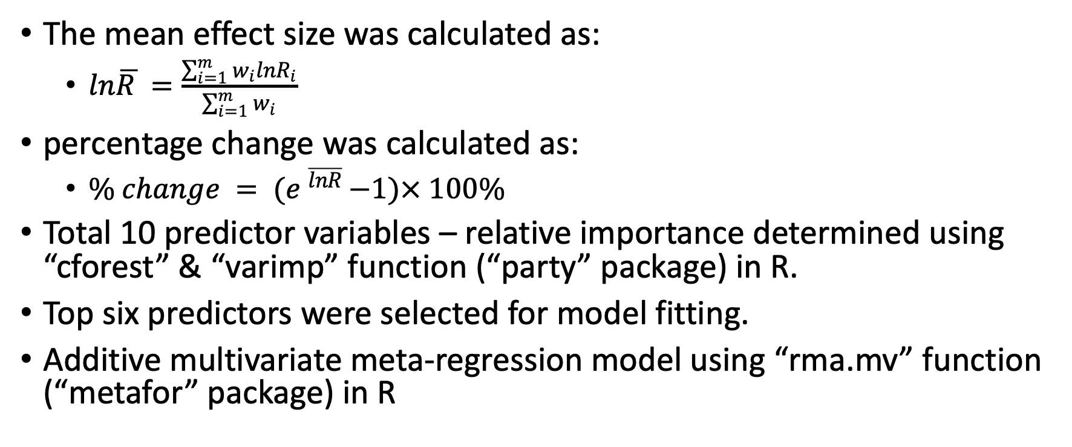
Data preparation and analysis
The mean effect size was calculated as:
$ln\overline{R }=\frac{\sum_{i=1}^{m}{w_{i}lnR_{i}}}{\sum_{i=1}^{m}{w_{i}}}$
percentage change was calculated as:
$\% change = {(e }^{\overline{lnR} }−1)× 100\%$
Total 10 predictor variables – relative importance determined using “cforest” & “varimp” function (“party” package) in R.
Top six predictors were selected for model fitting.
Additive multivariate meta-regression model using “rma.mv” function (“metafor” package) in R

Slide 13
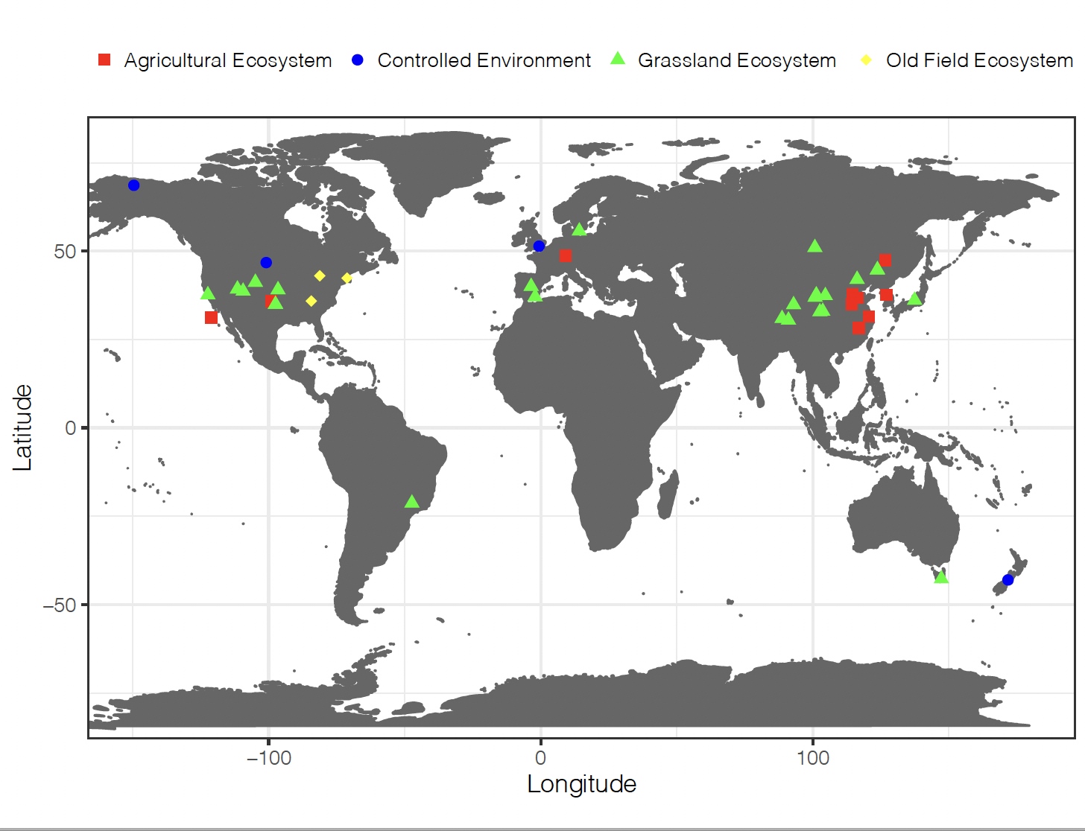
Results
Geographical distribution and ecosystem types of warming experiment included in meta-analysis

Slide 14
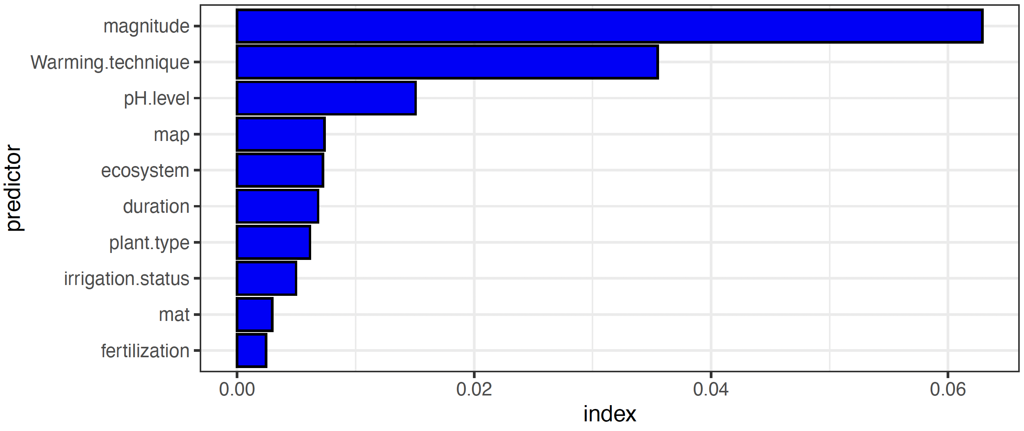
Variable importance

Slide 15
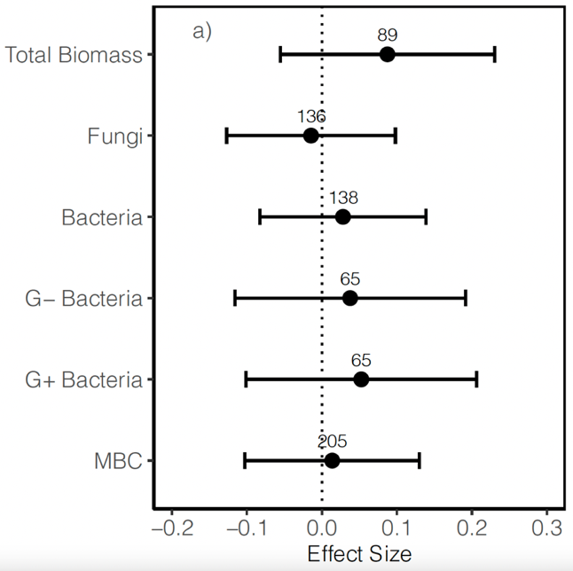
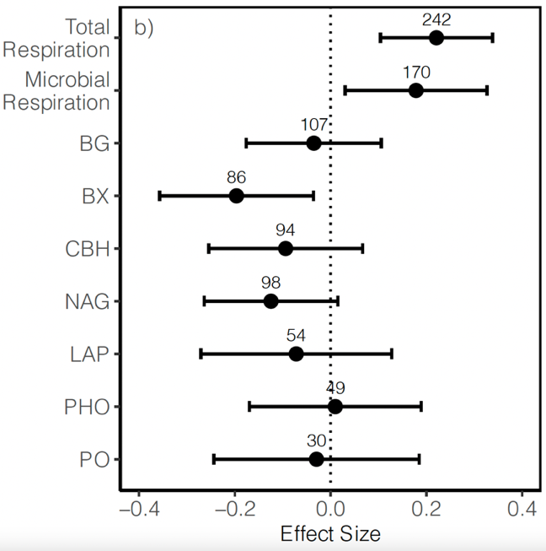
Warming effects on soil microbes

Slide 16
Effects of warming magnitude and duration
Warming effect on total biomass (z = -2.86, p = 0.0042), bacteria (z = -2.06, p = 0.039), fungi (z = -4.82, p < 0.001), and G- bacteria (z = -2.19, p = 0.0282) was negatively correlated to warming magnitude but warming effect on MBC and G+ bacteria was not correlated to magnitude of warming
Warming duration did not seem to have strong influence on either of these microbial groups
Similarly, warming effects on soil respiration ( z = 3.82, p = 0.0001) was positively correlated with warming magnitude and warming duration influences microbial respiration ( z = 2.165, p = 0.030).

Slide 17
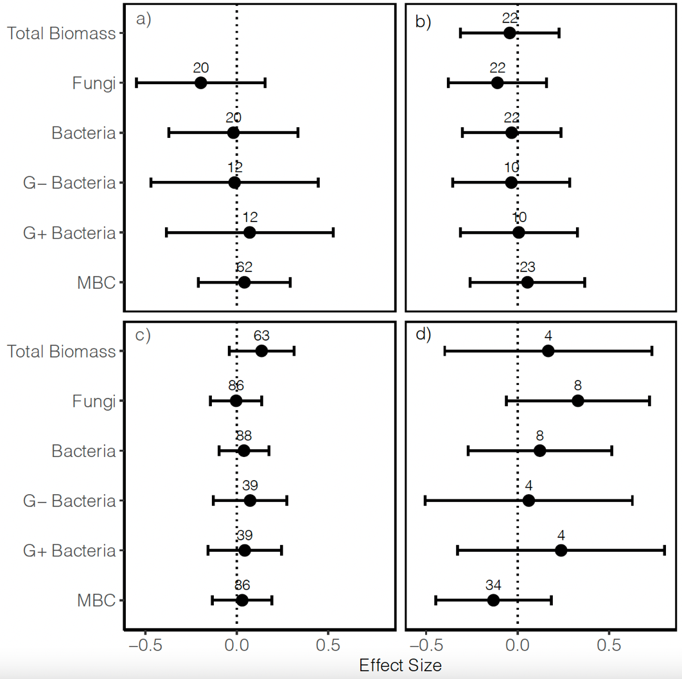
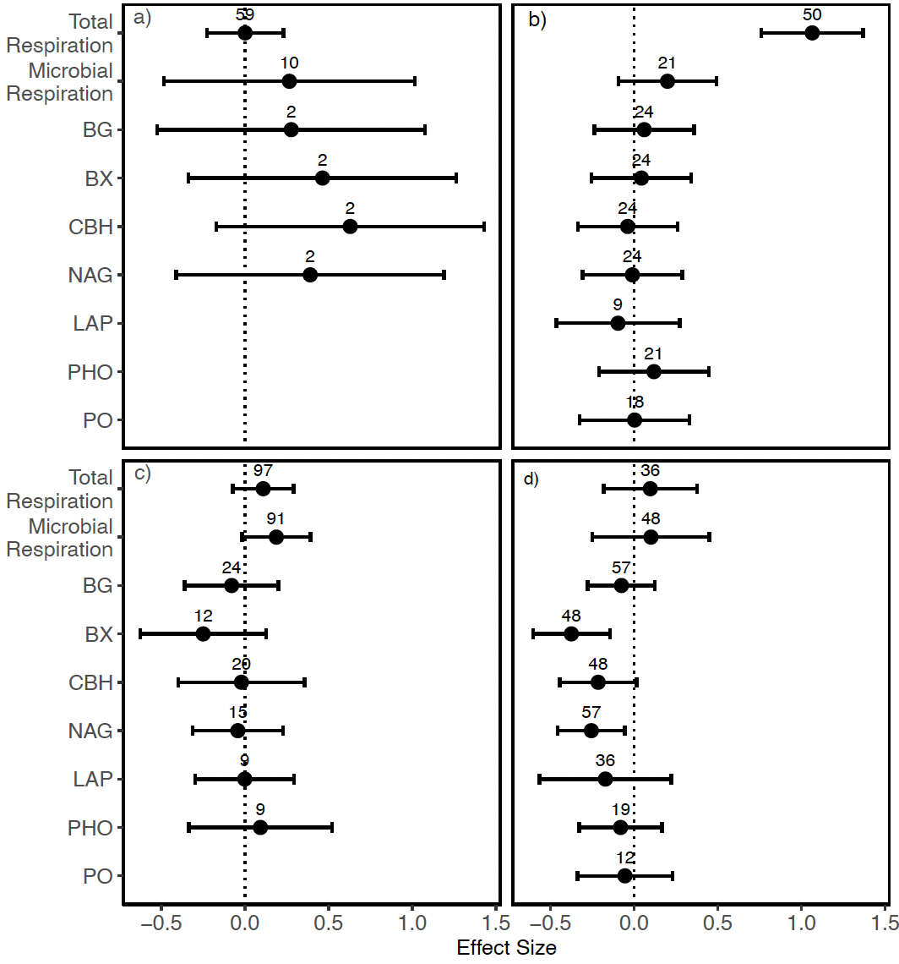
Microbial response to warming in different ecosystem
a = Agroecosystem, b = Controlled environment, c = Grassland, d = Old-field ecosystem

Slide 18
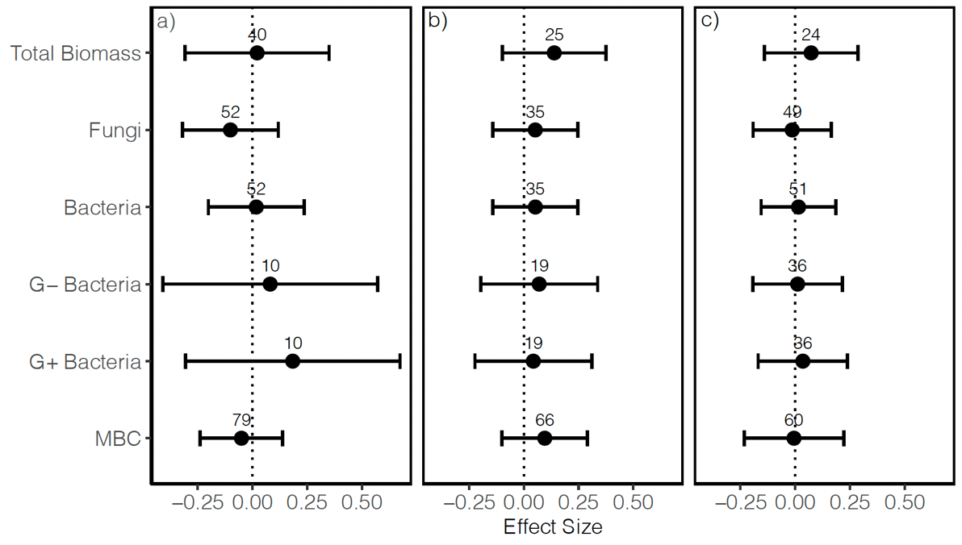
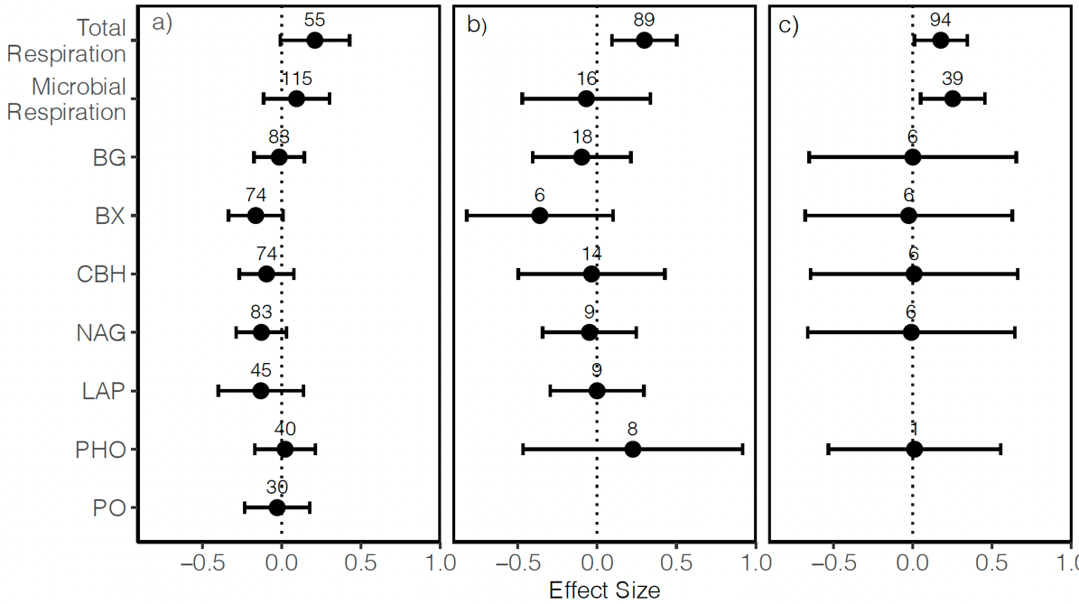
Microbial response to warming in different soil pH
a = Acidic (< 6.5), b = Alkaline (> 7.5), c = Neutral (6.5 – 7.5)

Slide 19
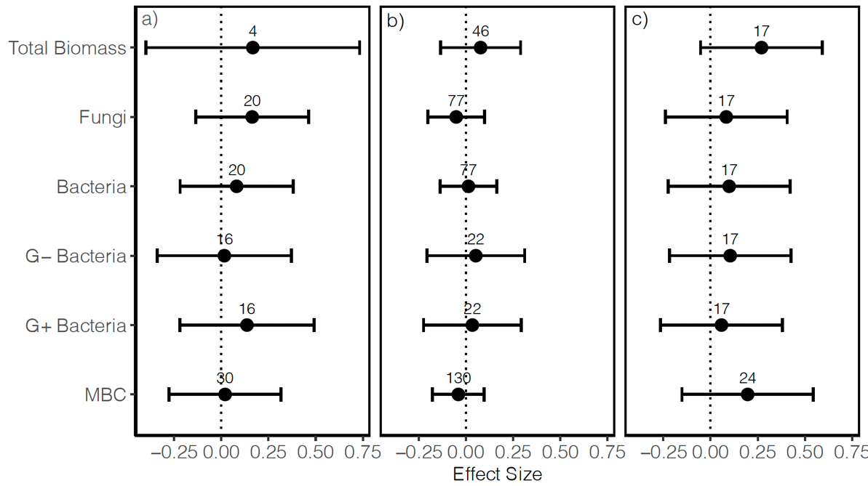
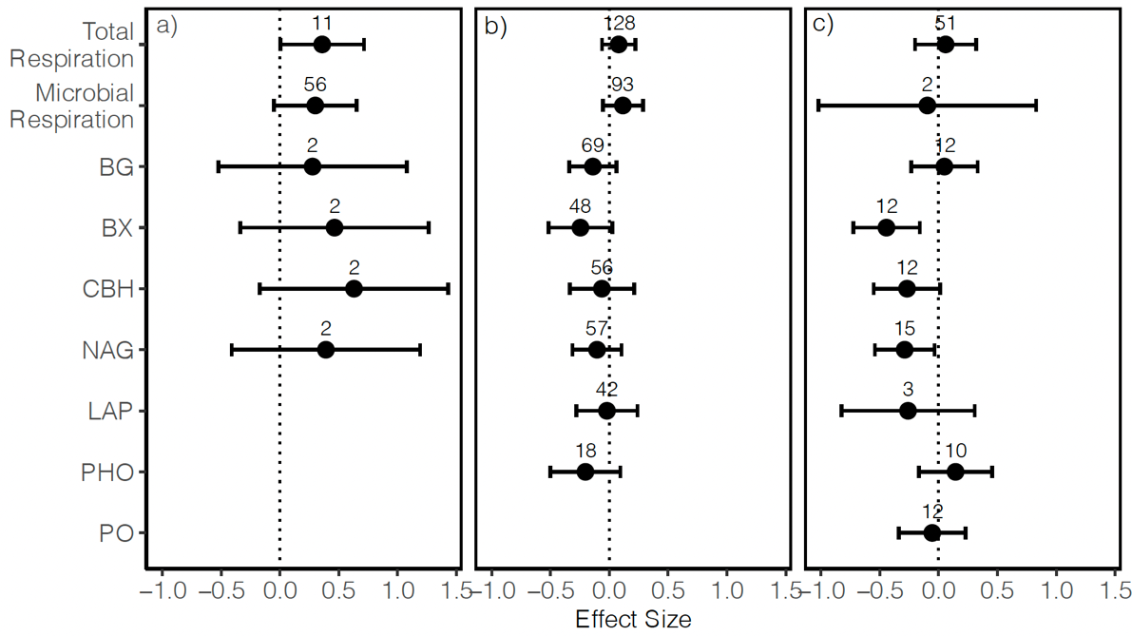
Microbial response to warming vary with different warming methods
a = heating cables, b = infrared heaters, c = open-top chambers

Slide 20
Conclusion
Warming increased total microbial biomass, bacterial biomass, and soil respiration while it decreased enzyme activities.
Higher degree of warming decrease microbial biomass and increased soil respiration.
Soil warming had strong impact on soil microbes in cultivated lands compared to undisturbed grassland.
Warming decreases fungal abundance but increase bacterial abundances in acidic pH – no effect on neutral and alkaline pH.
Open top method of warming had a positive correlation with microbial abundance.

Slide 21
Feedback!

